Slide 1
KNN (K-nearest Neighbor)
Introduction
K-nearest neighbors (KNN) algorithm is a type of supervised ML algorithm which can be used for both classification as well as regression predictive problems. However, it is mainly used for classification predictive problems in industry. The following two properties would define KNN well −
Lazy learning algorithm − KNN is a lazy learning algorithm because it does not have a specialized training phase and uses all the data for training while classification.
Non-parametric learning algorithm − KNN is also a non-parametric learning algorithm because it doesn’t assume anything about the underlying data.

Slide 2
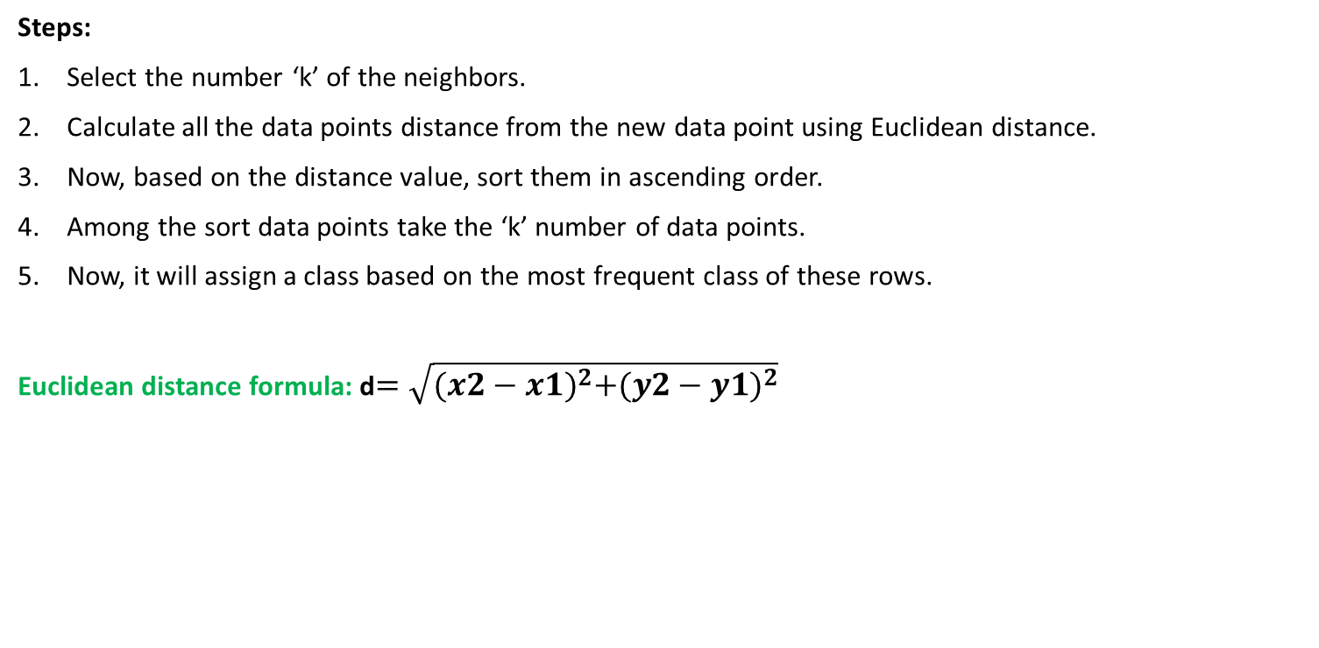
KNN (K-nearest Neighbor)
For classification
Steps:
Select the number ‘k’ of the neighbors.
Calculate all the data points distance from the new data point using Euclidean distance.
Now, based on the distance value, sort them in ascending order.
Among the sort data points take the ‘k’ number of data points.
Now, it will assign a class based on the most frequent class of these rows.
Euclidean distance formula: d$=\sqrt{{(x2−x1)}^{2}+{(y2−y1)}^{2}}$

Slide 3
KNN (K-nearest Neighbor)
cats
dogs
Let’s take K=4
We will have to find the
New data point, does it dog
Or cat.
New data point

Slide 4
KNN (K-nearest Neighbor)
cats
dogs
Let’s take K=4
We will have to find the
New data point, does it dog
Or cat.
New data point

Slide 5
KNN (K-nearest Neighbor)
cats
dogs
Let’s take K=4
The new data points
Will be cats.
New data point

Slide 6
KNN (K-nearest Neighbor)

Slide 7
KNN (K-nearest Neighbor)
Our new data point is (x2,y2) = (2.2, 3)

Slide 8
KNN (K-nearest Neighbor)
Sort by ascending order

Slide 9
KNN (K-nearest Neighbor)
If K=3 then maximum data point is ‘0’
So it will be cat.

Slide 10
KNN (K-nearest Neighbor)
If K=5 then maximum data point is ‘1’
So it will be dog.
The value of ‘k’ always odd number.
To find the optimal value of ‘k’ formula
Is, k = root(all data points)
Note: In this algorithm most important term is to pick the value of ‘K’.

Slide 11
KNN for Regression
KNN classification and Regression follow the same procedure. The only difference is in KNN classification we assign the new data point in that class that’s contain the maximum data points according to the ‘K’ value. But the KNN regression problem we just take the average value to find the target predication value.

Slide 12
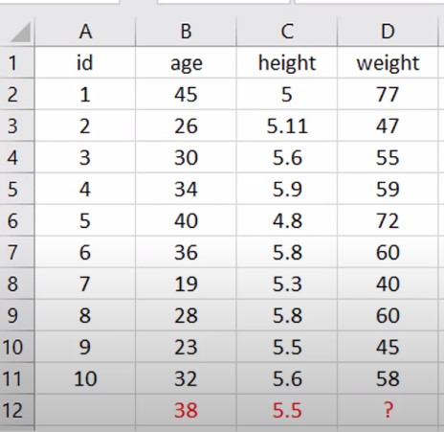
KNN for Regression
Datasets

Slide 13
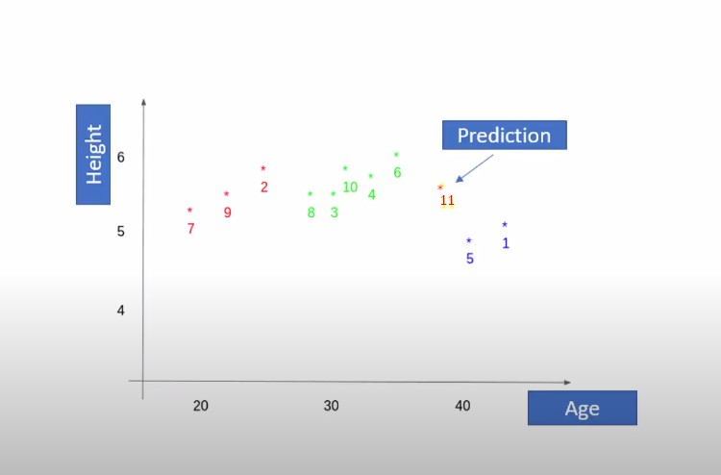
KNN for Regression

Slide 14
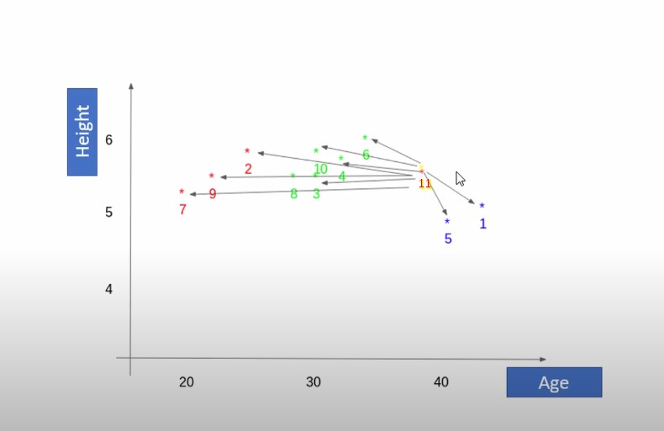
KNN for Regression

Slide 15
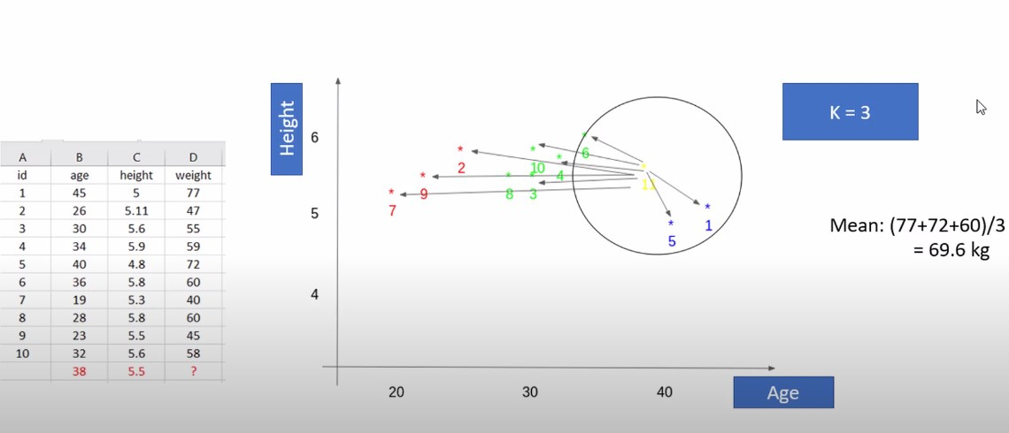
KNN for Regression

Slide 16
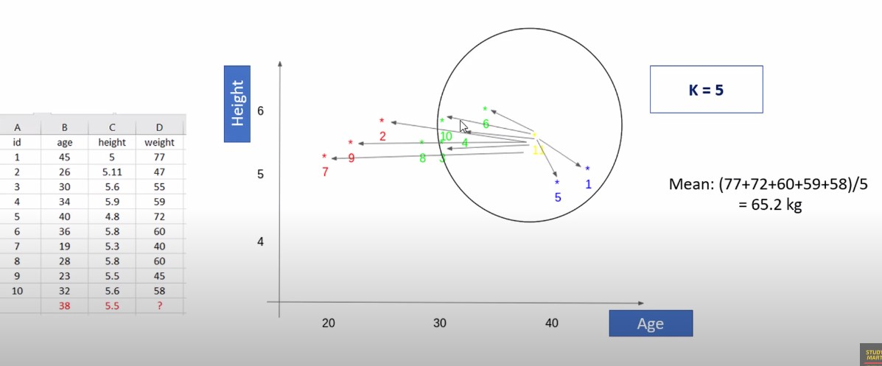
KNN for Regression

Slide 17
Advantages:
Works well with smaller datasets with less number of features.
Can be used for both classification and regression problems.
Easy to implement for multi-class classification problems.
Different distance criteria can be used. E.g.: Euclidean Distance, Manhattan Distance.
Disadvantages:
Choosing the optimum “k” value.
Less efficient with high dimensional data.
Doesn’t perform well on the imbalanced dataset.
Sensitive to Outliers.

